Slide 1

Chapter 8
THE BEHAVIOR OF GASES
  INTRODUCTION
Thus far frequent use has been made of the so-called ideal gas to illustrate the nature of changes in the thermodynamic state of a system. In this chapter the behavior of real gases is compared with ideal behavior, and the differences between the two are sought in the atomic or molecular properties of real gases. Although knowledge of the physical properties of a real gas is not required in a thermodynamic examination of the gas, an appreciation of the origin of physical properties provides a better understanding of the thermodynamic behavior.
  THE P-V-T RELATIONSHIPS OF GASES
Experimental observation has shown that, for all real gases,
(8.1)
where
P is the pressure of the gas
V is the molar volume of the gas
R is the universal gas constant
T is the absolute temperature of the gas
Thus, as the pressure of the gas approaches zero, isotherms plotted on a P-V diagram approach the form of a rectangular hyperbola given by the equation
(8.2)
Eq. (8.2) is the equation of an ideal gas and is called the ideal gas law. A gas which obeys this law over a range of states is said to behave ideally in this range of states, and a gas which obeys this law in all states is called a perfect gas. The perfect gas is a convenient model with which the behavior of real gases can be compared.
The variation of V with P at several temperatures for a typical real gas is shown in Fig.
8.1. The figure shows that, as the temperature of the gas is decreased, the shape of the
P–V isotherms changes, and, eventually, a value of T=T_{critical} is reached at which, at some
fixed pressure, P_{critical}, and fixed molar volume, V_{critical}, a horizontal inflexion occurs on the isotherm, i.e.,

Slide 2

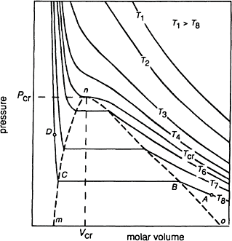
206 Introduction to the Thermodynamics of Materials
At temperatures less than T_{cr} two phases can exist. For example, if 1 mole of vapor, initially in the stated (in Fig. 8.1), is isothermally compressed at T₈, the state of the vapor
moves along the isotherm toward the state B. At B the pressure of the vapor is the saturated vapor pressure of the liquid at T₈, and further decrease in the volume of
Figure 8.1 P–V isotherms for a typical real gas.
the system causes condensation of the vapor and consequent appearance of the liquid phase. The liquid phase, which is in equilibrium with the vapor, appears at the state C, and V_{C} is the molar volume of the liquid at P_{C} and T₈. Further decrease in the volume of
the system causes further condensation, during which the states of the liquid and vapor phases remain fixed at C and B, respectively, and the total volume of the system, which is determined by the relative proportions of the liquid and vapor phases, moves along the horizontal line from B to C. Eventually condensation is complete, and the system existsalong the isotherm toward the state D. The large value of –(6P/6V)_{T} in the range of liquid states and the small value of –(6P/6V)_{T} in the range of vapor states indicate the low compressibility of the liquid phase and the high compressibility of the vapor phase. as 100% liquid in the state C. Further increase in pressure moves the state of the system along the isotherm toward the state D. The large value of –(6P/ 6V)_{T} in the range of liquid states and the small value of –(6P/ 6V)_{T} in the range of vapor states indicate the low compressibility of the liquid phase and the high compressibility of the vapor phase.

Slide 3
The Behavior of Gases 207
Fig. 8.1 also shows that, as the temperature is increased up to T_{cr}, the molar volume of the liquid in equilibrium with the vapor (corresponding to the point C) progressively in- creases and the molar volume of the vapor in equilibrium with the liquid (corresponding to the point B) progressively decreases. Thus, as the temperature is increased toward T_{cr}, the vapor in equilibrium with liquid becomes more dense, and the
liquid in equilibrium with the vapor becomes less dense. Eventually, when T_{cr} is reached, the molar volumes of the coexisting phases coincide at the state P_{cr}, T_{cr}. The critical point
is thus the meeting point of the locus of the point C with temperature (the line mn) and the locus of the point B with temperature (the line on), and the complete locus line mno defines the field of vapor-liquid equilibrium.
At temperatures higher than T_{cr} distinct two-phase equilibrium (involving two phases
separated by a boundary across which the properties of the system change abruptly) does not occur and thus the gaseous state cannot be liquified by isothermal compression at temperatures higher than T_{cr}. As the vapor can be condensed by isothermal compression
at temperatures lower than T_{cr}, the critical isotherm provides a distinction between the gaseous and vapor states and defines the gaseous state phase field. The phase fields are shown in Fig. 8.2.
Liquefaction of a gas requires that the gas be cooled. Consider the process path 1 → 2 in Fig. 8.2. According to this path, which represents the cooling of the gas at constant pressure, the phase change gas → liquid occurs at the point a, at which the temperature falls below T_{cr}. In fact, at temperatures greater than T_{cr} the criticaltemperature isotherm has no physical significance. In passing from the state 1 to the state 2 the molar volume of the system progressively decreases, and, hence, the density of the system progressively increases. No phase separation occurs between the states 1 and 2, and the system in the state 2 can equivalently be regarded as being a liquid of normal density or a gas of high density and, in state 1, can be regarded as being a gas of normal density or a liquid of low density. Physically, no distinction can be made between the liquid and gaseous states at pressures greater than P_{cr}, and consequently the system existing in these states is called a supercritical fluid. Thus, in the P–T phase diagram for the system (e.g., Fig. 7.10) the liquid-vapor equilibrium line (OB in Fig. 7.10) terminates at the critical point P_{cr}, T_{cr}.

Slide 4
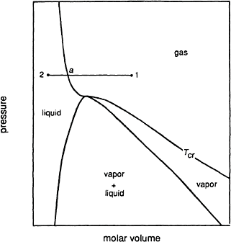


208 Introduction to the Thermodynamics of Materials
Figure 8.2 The fields of phase stability of a typical real gas.
8.3 DEVIATION FROM IDEALITY AND EQUATIONS OF STATE FOR REAL GASES
The deviation of a real gas from ideal behavior can be measured as the deviation of the compressibility factor from unity. The compressibility factor, Z, is defined as
(8.3)
which has the value of 1 for a perfect gas in all states of existence. Z itself is a function of the state of the system and, thus, is dependent on any two chosen dependent variables, e.g., Z=Z(P,T). Fig. 8.3 shows the variation of Z with P at constant temperature for several gases. For all of the gases in Fig. 8.3 the Z is a linear function of P up to about 10 atm and, hence, can be expressed as
or

Slide 5
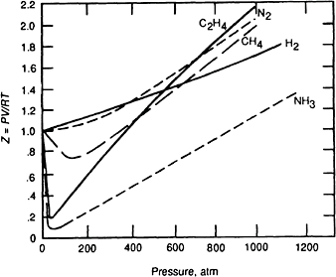
The Behavior of Gases 209
which can be written as
or
(8.4)
where b′=mRT and has the dimensions of volume.
Eq. (8.4) serves as the equation of state for the gases up to the pressures at which deviation from linear dependence of Z on P begins. Comparison with Eq. (8.4) shows that the deviations from ideal behavior, in the initial range of pressure, can be dealt with by making a correction to the volume term in the equation of state for an ideal gas. The need for such a correction is reasonable in view of the fact that an ideal gas is a system of noninteracting, volumeless particles, whereas the particles of real gases have small, but nevertheless finite, volumes. Thus, in a real gas, the volume available to the movement of Avogadro’s number of particles is less than the molar volume of the gas by an amount equal to the volume excluded by the particles themselves, and the ideal gas equation should be corrected for this effect. At first sight it might appear that the constant b′ in Eq. (8.4) is the volume excluded by the particles, but inspection of Fig. 8.3 shows that, with the exception of hydrogen, b′ is a negative quantity. Thus the above interpretation of b′ is incorrect, and Eq. (8.4) is a purely empirical equation which can be made to describe the behavior of real gases over a narrow range of low pressures in the vicinity of 0°C.
Figure 8.3 The variations, with pressure, of the compressibility factors of several gases at 0°C.

Slide 6
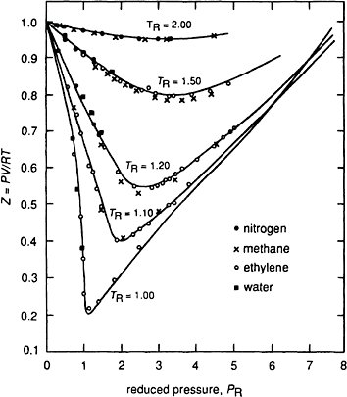
210 Introduction to the Thermodynamics of Materials
Figure 8.4 The variations of the compressibility factors of several gases with reduced pressure at several reduced temperatures.
If Fig. 8.3 is replotted as Z versus the reduced pressure, P_{R} (where P_{R}=P/P_{cr}) for fixed values of the reduced temperature, T_{R} (=T/T_{cr}), it is found that all gases lie on a single line. Fig. 8.4 shows a series of such plots. The behavior shown in Fig. 8.4 gives rise to the law of corresponding states, which states that all gases obey the same equation of state when expressed in terms of the reduced variables P_{R}, T_{R}, and V_{R} instead of P, T, and V.
the values of two reduced variables are identical for two gases then the gases have approximately equal values of the third reduced variable and are then said to be in corresponding states. Fig. 8.4 shows that the compressibility factor is the same function of the reduced variables for all gases (see Prob. 8.1).
8.4 THE VAN DER WAALS GAS
An ideal gas obeys the ideal gas law and has an internal energy, U, which is a function only of temperature. Consequently, an ideal gas is an assemblage of volumeless noninteracting particles, the energy of which is entirely the translational energy of motion of the constituent particles. Attempts to derive equations of state for real gases have attempted to modify the ideal gas equation by taking into consideration the facts that

Slide 7




The Behavior of Gases 211
The particles of a real gas occupy a finite volume and
The particles of a real gas are surrounded by force fields which cause them to interact with one another.
The magnitude of the importance of these two considerations depends on the state of the gas. For example, if the molar volume of the gas is large, then the volume fraction occupied by the particles themselves is small, and the magnitude of this effect on the behavior of the gas will be correspondingly small. Similarly, as the molar volume increases, the average distance between the particle increases, and thus the effect of interactions between particles on the behavior of the gas decreases. For a fixed number of moles of gas, an increase in the molar volume corresponds to a decrease in the density, n/V′, and such states of existence occur at low pressure and high temperature, as can be seen from the ideal gas equation, i.e.,
Thus, approach toward ideal behavior is to be expected as the pressure is decreased and the temperature is increased.
The most celebrated equation of state for nonideal gases, which was derived from considerations 1 and 2 above, is the van der Waals equation, which, for 1 mole of gas, is written as
where P is the measured pressure of the gas, a/V² is a correction term for the interactions which occur among the particles of the gas, V is the measured volume of the gas, and b is a correction term for the finite volume of the particles.* The term b is determined by considering a collision between two spherical particles. Two particles, of radius r, collide when the distance between their centers decreases to a value less than 2r, and, as is shown in Fig. 8.5a, at the point of collision the particles exclude a volume of
to all other particles. The volume excluded per particles is thus
*For n moles of van der Waals gas, the equation of state is
V=nV.
where

Slide 8
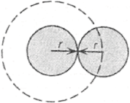
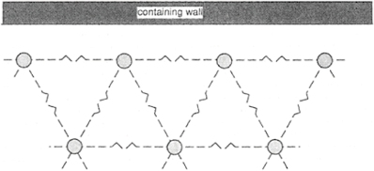
212 Introduction to the Thermodynamics of Materials
Figure 8.5 (a) Illustration of the volume excluded when two spheri- cal atoms collide.
Figure 8.5 (b) The interactions among atoms in a gas phase.
The volume excluded is thus four times the volume of all of the particles present and has the value b. Thus in 1 mole of gas, the volume (V–b) is that available for motion of the particles of the gas and is the molar volume which the gas would have were the gas ideal, i.e., if the particles were volumeless. The long-range attractive forces operating between the gas particles decrease the pressure exerted on the containing wall to a value less than that which would be exerted in the absence of the forces, van der Waals considered the following: The particles in the “layer” adjacent to the containing wall experience a net inward pull due to interaction with the particles in the next adjacent “layer.” These

Slide 9
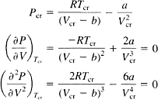

The Behavior of Gases 213
attractive forces give rise to the phenomenon of “internal pressure,” and the magnitude of the net inward pull (i.e., the decrease in the pressure exerted by the gas on the containing wall) is proportional to the number of particles in the “surface layer” and to the number of particles in the “next-to-the-surface layer.” Both of these quantities are proportional to the density of the gas, n/V, and hence the net inward pull is proportional to the square of
the density of the gas, or, for 1 mole of gas, equal to a/V², where a is a constant. Thus, if
P is the measured pressure of the gas, P+a/V² is the pressure which the gas would exert on the containing wall if the gas were ideal, i.e., in the absence of interactions among the particles. The effect is illustrated in Fig. 8.5b.
The van der Waals equation can be written as
which, being cubic in V, has three roots. Plotting V as a function of P for different values of T gives the family of isotherms shown in Fig. 8.6. As the temperature is increased the minimum and the maximum approach one another until, at T_{cr}, they coincide and produce
a horizontal inflexion on the P-V curve. At this, the critical, point T=T_{cr}, P=P_{cr}, and
V=V_{cr}, and the van der Waals equation gives
Solving these equations gives
(8.5)
and hence the constants a and b for any gas can be evaluated from knowledge of the values of T_{cr} and P_{cr}. Alternatively, the values of a and b can be obtained by fitting the
van der Waals equation to experimentally measured variations of V with T and P for real gases. The critical states, van der Waal constants, and values of Z at the critical point for several gases are listed in Table 8.1.

Slide 10
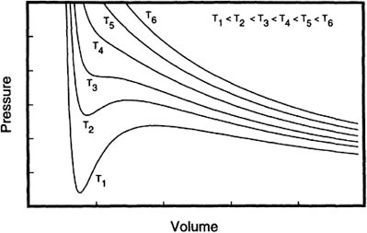

214 Introduction to the Thermodynamics of Materials
Figure 8.6 The isothermal variation of V with P for a van der Waals gas at several temperatures.
Table 8.1 The critical states, van der Waals constants, and values of Z at the critical points for several gases
Gas
T ,K P ,atm
cr cr
V ,cm³/mole
cr
b,liters/mole
Z
cr
He | 5.3 | 2.26 | 57.6 | 0.0341 | 0.0237 | 0.299
H₂ | 33.3 | 12.8 | 65.0 | 0.2461 | 0.0267 | 0.304
N₂ | 126.1 | 33.5 | 90.0 | 1.39 | 0.0391 | 0.292
CO | 134.0 | 35.0 | 90.0 | 1.49 | 0.0399 | 0.295
O₂ | 153.4 | 49.7 | 74.4 | 1.36 | 0.0318 | 0.293
CO₂ | 304.2 | 73.0 | 95.7 | 3.59 | 0.0427 | 0.280
NH₃ | 405.6 | 111.5 | 72.4 | 4.17 | 0.0371 | 0.243
H₂O | 647.2 | 217.7 | 45.0 | 5.46 | 0.0305 | 0.184
Consider the isothermal variation of V with P given by the van der Waals equation and shown in Fig. 8.7. Any increase in the pressure exerted on a system causes a decrease in the volume of the system, (6P/6V)_{T}<0. This is a condition of intrinsic stability and, in Fig. 8.7, this condition is violated over the portion JHF, which means that this portion of the curve has no physical significance. The effect of pressure on the equilibrium state of the

Slide 11
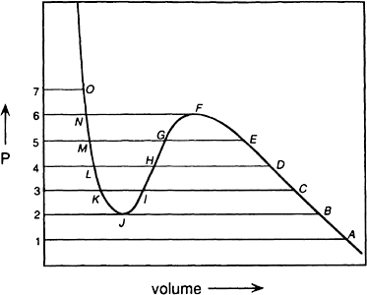


The Behavior of Gases 215
system can be obtained from a consideration of the variation of the Gibbs free energy with P along the isotherm. Eq. (5.12) gives the varia-tion of G with P at constant T as dG=VdP, and integration of this equation between the state (P,T) and (P_{A},T) gives
Figure 8.7 The isothermal variation, with pressure, of the volume of a van der Waals gas at a temperature below the critical temperature.
or
If an arbitrary value is assigned to G_{A}, then graphical integration of the integral f rom Fig. 8.7 allows the variation of G with P, corresponding to the variation of V with P in Fig. 8.7, to be drawn. The values of the integrals are listed in Table 8.2, and the variation of G with P is shown in Fig. 8.8.

Slide 12

216 Introduction to the Thermodynamics of Materials
Fig. 8.8 shows that, as the pressure is increased from ₁P , the value of G increases. At pressures greater than P₂ three states of existence become available to the system; for example, at P₃ the three states are given by the points I, K, and C. The stable, or
equilibrium, state is that with the lowest Gibbs free energy, and hence over the range of pressure from P₂ to P₄ the stable states lie on the line BCD. As the pressure is increased
above P₄ the state with the lowest Gibbs free energy no longer lies on the original line (the continuation of the line BCD) but lies on the line LMN. The change of stability at P₄ corresponds to a change of phase at this point, i.e., at pressures less than P₄ one phase is stable, and at pressures greater than P₄ another phase is stable. At low pressures (P<P₄), the system exists as a vapor, and at high pressures (P>P₄), it exists as a liquid. At P₄ G_{D},
which is the molar Gibbs free energy of the vapor phase, equals GL, which is the molar Gibbs free energy of the liquid phase, and thus vapor and liquid coexist in equilibrium with one another at the state P₄,T. In Fig. 8.7 a tie-line connects the points D and L across
a two-phase region. In Fig. 8.8 the lines DF and LJ represent, respectively, the metastable
Table 8.2 Graphical integration of Fig. 8.7
 | =G_{A}+area lAB2
G_{C} | =G_{A}+area lAC3
G_{D} | =G_{A}+area lAD4
G_{E} | =G_{A}+area lAE5
G_{F} | =G_{A}+area lAF6
G_{G} | =G_{A}+area lAE5 | +area EFG
G_{H} | =G_{A}+area lAD4 | +area DFH
G_{I} | =G_{A}+area lAC3 | +area CFI
G_{J} | =G_{A}+area lAB2 | +area BFJ
G_{K} | =G_{A}+area lAC3 | +area CFI | –area IJK
G_{L} | =G_{A}+area lAD4 | +area DFH | –area HJL
G_{M} | =G_{A}+area lAEF | +area EFG | –area GJM
G_{N} | =G_{A}+area lAF6 |  | –area FJN
G_{o} | =G_{A}+area lAF6 |  | –area FJN+area 6NO7

Slide 13
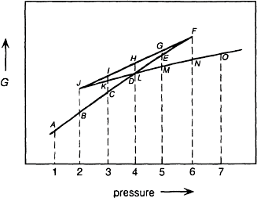


The Behavior of Gases 217
Figure 8.8 Schematic representation of the variation, with pressure, of the molar Gibbs free energy of a van der Waals gas at a constant temperature lower than the critical temperature.
vapor and metastable liquid states. Thus, in the absence of nucleation of the liquid phase from the vapor phase at the state D, supersaturated vapor would exist along the line DEF, and, in the absence of nucleation of the vapor phase from the liquid phase at the state L, supersaturated liquid would exist along the line LKJ. In view of the violation of the criterion for intrinsic stability over the states path JHF, the states represented by this line in both Fig. 8.7 and Fig. 8.8 have no physical significance.
It is thus seen that the van der Waals equation predicts the phase change which occurs in the system at temperatures less than T_{cr}. At any temperature below T_{cr}, the value of P
for equilibrium between the vapor and liquid phases, e.g., P₄ in Figs. 8.7 and 8.8, is that which the area HFD equals the area LJH in Fig. 8.7.
The measured values of T_{cr} and P_{cr} for carbon dioxide are, respectively, 31°C and 72.9 atm. Thus, from Eq. (8.5),
and
in which case the van der Waals equation for CO₂ is given as

Slide 14
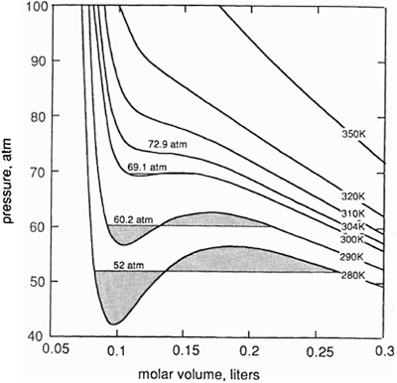
218 Introduction to the Thermodynamics of Materials
The variation of P with V, given by this equation, is shown at several temperatures in Fig. 8.9, in which it is seen that the 304 K isotherm exhibits a horizontal inflexion at
Figure 8.9 P–V isotherms for van der Waals carbon dioxide.
the critical point. At temperatures lower than 304 K the isotherms show the expected maxima and minima. The variation, with temperature, of the saturated vapor pressure of van der Waals liquid CO₂ can be determined by finding the tie-line on each isotherm which gives equal areas DFH and LJH as explained with reference to Fig. 8.7.
Alternatively, the variation of the molar Gibbs free energy with pressure can be determined along each isotherm by graphical integration of the variation of V with P. These relationships are shown for several temperatures in Fig. 8.10, which shows the variation of the saturated vapor pressure of liquid CO₂ (the points P) with temperature. Fig. 8.10 also shows that, as the temperature increases toward the critical point, the range of nonphysical states (J to F in Fig. 8.8) diminishes and finally disappears at T_{cr}. At
temperatures higher than T_{cr} the full-line indicates that one phase alone is stable over the entire range of pressure. As G_{A} in Eq. (8.6) is a function of temperature, the positions of the isotherms in Fig. 8.10 with respect to one another ar e arbitrary; only the P-axis is quantitatively significant.

Slide 15
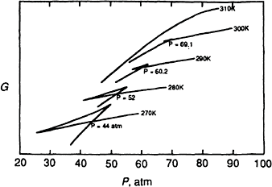
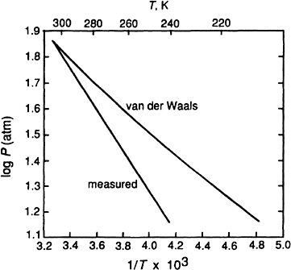
The Behavior of Gases 219
The variation of the saturated vapor pressure of liquid CO₂ with temperature, obtained
from the van der Waals equation and plotted as the logarithm of P vs. the reciprocal of the absolute temperature, is shown in Fig. 8.11. Fig. 8.11 also shows the variation of the measured saturated vapor pressure with temperature. Comparison shows that the van der Waals equation predicts values of vapor pressure which are higher than the measured
Figure 8.10 The variations of G with P for van der Waals carbon dioxide at several temperatures.
Figure 8.11 Comparison of the variation, with temperature, of the vapor pressure of van der Waals liquid carbon dioxide with the measured vapor pressures.

Slide 16




220 Introduction to the Thermodynamics of Materials
values, although the difference between the two values decreases with increasing temperature. Consequently, the van der Waals equation predicts a value of the molar latent heat of evaporation of liquid CO₂ which is less than the measured value, with OH_{evap} being obtained as –2.303 R×(the slope of the line) in Fig.8.11. The molar latent heat of evaporation of a liquified van der Waals gas can be calculated as follows:
where V_{v} and V_{l} are, respectively, the molar volumes of the coexisting vapor and liquid
phases, and P is the saturated vapor pressure, at the temperature T. From Eqs. (3.12) and (5.33),
which, applied to the van der Waals gas, gives
Integration gives
in which the integration constant is a function of temperature. Thus
(8.6)
(8.7)

Slide 17


The Behavior of Gases 221
Eq. (8.7) thus correctly predicts that OH_{evap} for a van der Waals gas rapidly falls to zero as the temperature approaches T_{cr}, in which state V_{v}=V_{l}.
Although van der Waals developed his equation from a consideration of the physical factors causing nonideal behavior, the requirement that the pressure, volume, and temperature at the critical point be known for calculation of a and b means that the equation is empirical. This, however, does not detract from the usefulness of the equation in representing the behavior of a gas which exhibits a relatively small departure from ideality.
8.5 OTHER EQUATIONS OF STATE FOR NONIDEAL GASES
Other examples of derived equations of state for nonideal gases are the Dieterici equation
and the Berthelot equation
Neither of these equations has a fundamental basis, and general empirical equations are normally used. Examples of such equations are the Beattie-Bridgeman equation, which contains five constants in addition to R and fits the P-V-T relationships over wide ranges of temperature and pressure, and the Kammerlingh-Onnes, or virial, equation of state. In the latter equation it is assumed that PV/RT is a power series of P or 1/V, i.e.,
or

Slide 18



222 Introduction to the Thermodynamics of Materials
The product PV is called the virial, B or B′ is called the first virial coefficient, C or C′ is called the second virial coefficient, etc., and the virial coefficients are functions of temperature. In both equations, as pressure approaches zero and volume approaches infinity, PV/RT → l. The virial equation converges rapidly in the gas phase, and thus the equation of state can be represented by the virial expansion over the entire range of densities and pressures. In practice, however, the virial equation is used only when the first few terms need to be retained. At low pressures or densities,
or
both of which are expressions of Eq. (8.4).
8.6 THE THERMODYNAMIC PROPERTIES OF IDEAL GASES AND MIXTURES OF IDEAL GASES
The variation of the molar Gibbs free energy of a closed system of fixed composition, with pressure at constant temperature, is given by the fundamental equation, Eq. (5.25) as
For 1 mole of an ideal gas, this can be written as
(8.8)

Slide 19


The Behavior of Gases 223
and thus, for an isothermal change of pressure from P₁ to P₂ at T,
(8.9)
As Gibbs free energies do not have absolute values (only changes in G can be measured), it is convenient to choose an arbitrary reference state from which the changes in Gibbs free energy can be measured. This reference state is called the standard state and is chosen as being the state of 1 mole of pure gas at 1 atm pressure and the temperature of interest. The Gibbs free energy of 1 mole of gas in the standard state G(P=1, T) is designated G°(T) and thus, from Eq. (8.9), the Gibbs free energy of 1 mole of gas at any other pressure P is given as
or simply
(8.10)
In Eq. (8.10) notice that the logarithm of a dimensionless ratio, P/l, occurs in the right-hand term.
Mixtures of Ideal Gases
Before discussing the thermodynamic properties of mixtures of ideal gases, it is necessary to introduce the concepts of mole fraction, partial pressure, and partial molar quantities.
Mole fraction. When a system contains more than one component, i.e., when the composition of the system is variable, it is necessary to invent a means of expressing the composition. Several composition variables are in use, of which only one—the mole fraction—has any theoretical significance. The mole fraction, X_{i}, of the component i is
defined as the ratio of the number of moles of i in the system to the total number of moles of all of the components in the system. For example, if the system contains n_{A} moles of A,
n_{B} moles of B, and n_{C} moles of C, then

Slide 20



224 Introduction to the Thermodynamics of Materials
and
The convenience of the use of mole fraction as a composition variable lies in the fact that the sum of the mole fractions of all of the components in a system is unity. For example, in the above system X_{A}+X_{B}+X_{C}=1.
Dalton’s law of partial pressures. The pressure P exerted by a mixture of ideal gases is equal to the sum of the pressures exerted by each of the individual component gases, and the contribution made to the total pressure, P, by each individual gas is called the partial pressure of that gas. The partial pressure exerted by a component gas, p_{i}, is thus the
pressure that it would exert if it alone were present. In a mixture of the ideal gases A, B,
and C,
Consider a fixed volume V′, at the temperature T, which contains n_{A} moles of an ideal gas
A. The pressure exerted is thus
(8.11)
If, to this constant volume containing n_{A} moles of gas A, n_{B} moles of ideal gas B are added, the pressure increases to
(8.12)
Division of Eq. (8.11) by Eq. (8.12) gives

Slide 21



The Behavior of Gases 225
which, for the gas A in the mixture, can be written as
or
(8.13)
Thus, in a mixture of ideal gases, the partial pressure of a component gas is the product of its mole fraction and the total pressure of the gas mixture. Eq. (8.13) is called Dalton's law of partial pressures.
Partial molar quantities. The molar value of any extensive state property of a component of a mixture is called the partial molar value of the property. This value is not necessarily equal to the value of the molar property of the pure component. The partial molar value of an extensive property Q of the component i in a mixture of components i, j, k,…is formally defined as
(8.14)
where Q′ is the value of the extensive property for an arbitrary quantity of the mixture.
is thus the rate of change of the value of Q′ with ni at constant temperature, pressure, and composition of the mixture, and, being a state property, is a function of temperature,
pressure, and composition. The definition of can also be made as follows. If 1 mole of i is added, at constant temperature and pressure, to a quantity of mixture which is sufficiently large that the addition causes virtually no change in the composition of the
mixture, the consequent increase in the value of Q′ equals the value of in the mixture. In the case of the extensive property being the Gibbs free energy,
and, from Eq. (5.16), it is seen that

Slide 22



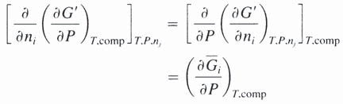

226 Introduction to the Thermodynamics of Materials
i.e., the partial molar Gibbs free energy of a component in a mixture equals the chemical potential of the component in the mixture.
The relationships among the various state functions developed in the preceding chapters are applicable to the partial molar properties of the components of a system. For example, the fundamental equation, Eq. (5.25), at constant T and composition gives
where G′ is the Gibbs free energy of the system and V′ is the volume of the system. For a variation in n_{i}, the number of moles of component i in the system, at constant T, P, and n_{j,}
But, by definition
and, as G is a state function, in which lose the order of partial differentiation has no influence on the result
Hence
which is simply the application of Eq. (5.25) to the component i in the system. Thus, for the ideal gas A in a mixture of ideal gases,

Slide 23





The Behavior of Gases 227
The partial molar volume,
, in a gas mixture is
Differentiation of Eq. (8.13) at constant T and composition gives dp_{A}=X_{A}dP, and hence
Integration between the limits p_{A}=p_{A} and p_{A}=1 gives
(8.15)
Eq. (8.15) could also have been obtained by integrating Eq. (8.8) from the standard state
p_{A}=P_{A}=1, X_{A}=1, T to the state p_{A}, X_{A}, T.
The Heat of Mixing of Ideal Gases
For each component gas in a mixture of ideal gases
where P is the total pressure of the gas mixture at the temperature T. Dividing by T and differentiating with respect to T at constant pressure and composition gives
But, from Eq. (5.37)
(8.17)

Slide 24
228 Introduction to the Thermodynamics of Materials
and thus
(8.18)
i.e., the partial molar enthalpy of ideal gas i in a mixture of ideal gases equals the molar enthalpy of pure i, and thus the enthalpy of the gas mixture equals the sum of the enthalpies of the component gases before mixing, i.e.,
(8.19)
where OH′^{mix} is the change in the enthalpy caused by the process of mixing.
As is, by definition, a function only of temperature, then, from Eqs. (8.16) and
(8.17) it is seen that is a function only of temperature. Thus, in addition to being
independent of composition, is independent of pressure. The zero heat of mixing of ideal gases is a consequence of the fact that the particles of an ideal gas do not interact with one another.
The Gibbs Free Energy of Mixing of Ideal Gases
For each component gas i in a mixture of ideal gases,
and for each component gas before mixing
where p_{i} is the partial pressure of i in the gas mixture and P_{i} is the pressure of the pure gas i before mixing.
The mixing process, being a change of state, can be written as unmixed components (state 1) → mixed components (state 2)

Slide 25
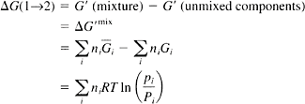



The Behavior of Gases 229
and
(8.20)
The value of OG′^{mix} depends, thus, on the value of p and p for each gas. If, before
i i
mixing, the gases are all at the same pressure, i.e., if P_{i}=P_{j}=P_{k}=… and mixing is carried
out at total constant volume such that the total pressure of the mixture, P_{mix}, equals the initial pressures of the gases before mixing, then, as p_{i}/p_{i}=X_{i,}
(8.21)
As the values of X are less than unity, OG′^{mix} is a negative quantity, which corresponds
i
with the fact that the mixing of gases is a spontaneous process.
The Entropy of Mixing of Ideal Gases
As OH′^{mix}=0 and
then
(8.22)
or, if P_{i}=P_{j}=P_{k}=…=P then
(8.23)
which is seen to be positive, in accord with the fact that the mixing of gases is a spontaneous process.

Slide 26


230 Introduction to the Thermodynamics of Materials
8.7 THE THERMODYNAMIC TREATMENT OF NONIDEAL GASES
Eq. (8.10) showed that, at any temperature, the molar Gibbs free energy of an ideal gas is a linear function of the logarithm of the pressure of the gas. This property arises from the ideal gas law which was used in the derivation of Eq. (8.10), and thus, if the gas is not ideal, then the relationship between the logarithm of the pressure of the gas and its molar Gibbs free energy is not linear. However, in view of the simple form of Eq. (8.10), a function is invented which, when used in place of pressure in Eq. (8.10), gives a linear relationship between the molar Gibbs free energy of an nonideal gas and the logarithm of the function. This function is called the fugacity, f, and is partially defined by the equation
The integration constant is chosen such that the fugacity approaches the pressure as the pressure approaches zero, i.e.,
in which case
(8.24)
where G° is the molar Gibbs free energy of the gas in its standard state, which is now defined as that state in which f=1 at the temperature T. (The standard state for an ideal gas was defined as being P=1,T.)
Consider a gas which obeys the equation of state
where a is a function only of temperature and is a measure of the deviation of the gas from ideality. Eq. (5.12) gives dG=VdP at constant T, and Eq. (8.24) gives dG=RTd ln f at constant T. Thus, at constant T,

Slide 27







The Behavior of Gases 231
and hence
(8.25)
Integration between the states P=P and P=0, at constant T gives
(8.26)
As f/P=1 when P=0, then In (f/P)=0 when P=0, and hence
In order that a can be taken as being independent of pressure, the deviation of the gas from ideality must be small, in which case a is a small number. Thus,
and hence
If the gas behaved ideally, then the ideal pressure, P_{id}, would be given as RT/V. Thus
which shows that the actual pressure of the gas is the geometric mean of its fugacity and the pressure which it would exert if it behaved ideally. It is also seen that the percentage error involved in assuming that the fugacity is equal to the pressure is the same as the percentage departure from the ideal gas law.
Alternatively, the fugacity can be considered in terms of the compressibility factor Z. From Eq. (8.25)

Slide 28




232 Introduction to the Thermodynamics of Materials
But Z=PV/RT, and hence
and
(8.28)
This can be evaluated either by graphical integration of a plot of (Z–1)P vs. P at constant T or by direct integration if Z is known as a function of P, i.e., if the virial equation of state of the gas is known.
For example, the variation of PV (cm³·atm) with P in the range 0–200 atm for nitrogen gas at 0°C is represented by the equation
Thus, dividing by RT=22,414.6 at 0°C gives

Slide 29
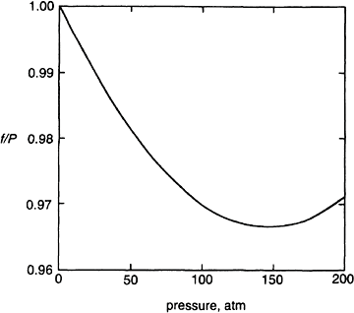

The Behavior of Gases 233
Figure 8.12 The variation of f/P with pressure for nitrogen gas at 0°C.
This variation of Z with P is shown graphically in Fig. 8.3. From integration of Eq. (8.28), In (f/P) is obtained as
This variation of f/P with P is shown in Fig. 8.12.
The change in the molar Gibbs free energy of an nonideal gas caused by an isothermal change in pressure can be calculated from either
or
The correspondence between these two approaches is illustrated as follows. The virial equation of state of the gas is

Slide 30





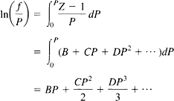
234 Introduction to the Thermodynamics of Materials
Then
and so, for the change of state of 1 mole of gas from (P₁, T) to (P₂, T),
If the gas had been ideal, then
and so the contribution to change in the molar Gibbs free energy arising from the nonideality of the gas is
Alternatively, dG=RT d ln f where, from Eq. (8.29),

Slide 31

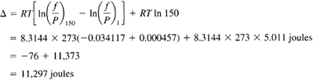


The Behavior of Gases 235
Now
and so
in agreement with the above.
Thus for 1 mole of nitrogen at 0°C, the difference between the Gibbs free energy at
P=150 atm and that at P=1 atm is
The contribution due to the nonideality of nitrogen is thus seen to be only 76 joules in almost 11,300 joules.
The number of terms which must be retained in the virial equation depends on the magnitude of the range of pressure over which it must be applied. For example, in the virial equation for nitrogen at 0°C only the first term is needed up to 6 atm and only the first two terms are needed up to 20 atm. When only the first term is needed the expression is
or
and hence –BRT=a in Eq. (8.25) and a is a function only of temperature.
Consider a nonideal gas which obeys the equation of state PV=RT(1+BP). The work done by this nonideal gas in a reversible, isothermal expansion from P₁ to P₂ is the same
as that done when an ideal gas is reversibly and isothermally expanded from P₁ to P₂ at
the same temperature. However, the work done by the non-ideal gas in a reversible, isothermal expansion from V₁ to V₂ is greater than that done when an ideal gas is

Slide 32



236 Introduction to the Thermodynamics of Materials
reversibly and isothermally expanded from V₁ to V₂ at the same temperature. Consider why this is so.
For the ideal gas V=RT/P, and for the nonideal gas V=RT/P+BRT. Thus, on a P-V diagram any isotherm for the nonideal gas is displaced from the isotherm for the ideal gas by the constant increment in volume BRT, as shown in Fig. 8.13. Because of the constant displacement the area under the isotherm for the ideal gas between P₁ and P₂ (the area
abcd) is the same as the area under the isotherm for the nonideal gas between the same pressures (the area efgh). Thus the same amount of work is done by both gases in expanding isothermally from P₁ to P₂.
For the ideal gas,
and for the nonideal gas
but, as V=RT/P+BRT and hence, at constant T, dV=–RT(dP/P²), then
However, as any isotherm for the nonideal gas also lies above the isotherm for the ideal gas (for a positive value of B), the work done by the nonideal gas in expanding isothermally and reversibly from V₁ to V₂ (the area aijd) is greater than that done by the ideal gas in isothermally and reversibly expanding between V₁ and V₂ (the area abcd).

Slide 33
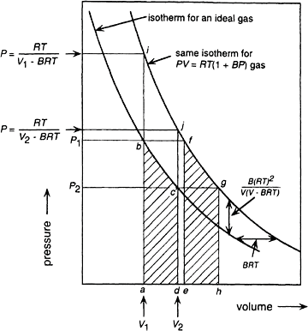



The Behavior of Gases 237
Figure 8.13 Isotherms for an ideal gas and a non-ideal gas.
The vertical separation between the two isotherms is
For the ideal gas, w_{ideal gas}=RT ln (V₂/V₁) and for the nonideal gas,
where

Slide 34

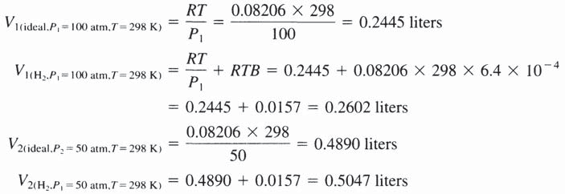



238 Introduction to the Thermodynamics of Materials
such that
Consider the comparison of the behavior of hydrogen gas, for which PV= RT(1+0.0064P), with that of an ideal gas in reversible isothermal expansions of 1 mole between P₁=100 atm and P₂=50 atm at 298 K:
Thus, for the change of state
and
At V=0.2445 liters, T=298 K, P_{ideal gas}=100 atm, and

Slide 35

The Behavior of Gases 239
and at V=0.489 liters, T=298 K, P_{ideal gas}=50 atm, and
8.8 SUMMARY
An ideal gas is an assemblage of volumeless noninteracting particles which obeys the ideal gas law, PV=RT. The internal energy of an ideal gas arises solely from the translational motions of the gas particles and, hence, is a function only of temperature. The enthalpy of an ideal gas is also a function only of temperature. A consequence of the ideal gas law is that, at constant temperature, the Gibbs free energy of an ideal gas is a linear function of the logarithm of the pressure of the gas. As Gibbs free energies do not have absolute magnitudes (only differences can be measured) it is convenient to measure changes in Gibbs free energy from some arbitrary state. This state is chosen as P=1 atm at the temperature of interest and is called the standard state. Thus, the difference between the molar Gibbs free energy in the state P, T and that in the standard state, P=1 atm, T is OG=RT ln P. The deviations of real gases from ideal behavior are caused by the atoms or molecules of real gases having finite volumes and by the interactions which occur among the atoms. Various attempts have been made to correct the ideal gas law for these effects, and the best-known derived equation is the van der Waals equation of state, which can be applied to gases which show small deviations from ideality. This equation predicts the condensation of vapor caused by compression at temperatures below the critical temperature, but does not give the correct dependence on temperature of the saturated vapor pressure of the liquid phase. Generally, measured variations of the molar volumes of gases with P and T are fitted to power series
equations, in P or 1/V, of the function PV. Such equations are called virial equations.
The compressibility factor, Z=PV/RT, of all real gases at constant reduced temperature,
T_{R}=T/T_{cr}, is the same function of the reduced pressure, P_{R}=P/P_{cr}. This gives rise to
the law of corresponding states, which states that when two gases have identical values of two reduced variables, they have almost identical values of the third reduced variable.
Consideration of the thermodynamic behavior of nonideal gases is facilitated by introduction of the fugacity, f which is defined by the equation dG=RT d ln f and by the condition f/P → 1 as P → 0. Thus the standard state for a nonideal gas is that in which the fugacity is unity at the temperature of interest. For small deviations from ideality, the pressure of the gas is the geometric mean of its fugacity and P_{id}, the pressure which the gas would exert if it were ideal.
The composition of a mixture of gases is most conveniently expressed in terms of the mole fractions of its component gases, and if the mixture is ideal, the partial pressures ex- erted by the component gases are related to the total pressure P and the mole fraction X_{i} by p_{i}=X_{i}P. This equation is called Dalton's law of partial pressures. In a mixture of

Slide 36



240 Introduction to the Thermodynamics of Materials
ideal gases the partial molar Gibbs free energy of a component gas is a linear function of the logarithm of its partial pressure, and in a mixture of nonideal gases is a linear function of the logarithm of its fugacity.
As the atoms in an ideal gas do not interact with one another no change in enthalpy occurs when different ideal gases are mixed, i.e., the enthalpy change of mixing of ideal
gases, OH′^{mix}, is zero. The entropy change occurring when ideal gases are mixed arises solely from complete randomization of the different types of atoms in the available
volume, and thus, as OH^{mix}=0, OG^{mix}=–TOS^{mix}.
8.9 NUMERICAL EXAMPLES Example 1
Assuming that nitrogen behaves as a van der Waals gas with a=1.39 l²·atm/mole² and
b=39.1 cm³/mole, calculate the change in the Gibbs free energy and the change in entropy when the volume of 1 mole of nitrogen is increased from 1 to 2 liters at 400 K.
For a van der Waals gas
and thus
(i)
(ii)
At constant temperature

Slide 37

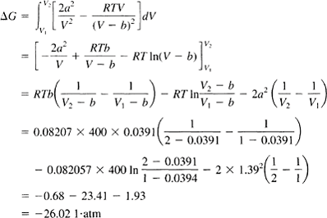



The Behavior of Gases 241
which, from Eq. (i), gives
Integrating between V₂ and V₁ gives
From Eq. (6.17), at constant temperature,
where
From Eq. (ii), at constant pressure

Slide 38


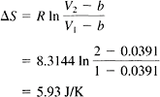
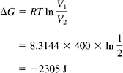

242 Introduction to the Thermodynamics of Materials
and thus, for a van der Waals gas
and
Therefore,
If the nitrogen had behaved as an ideal gas the changes in Gibbs free energy and entropy would have been
and

Slide 39



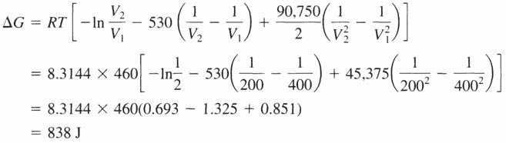
The Behavior of Gases 243
Example 2
The virial equation of state for n-butane at 460 K is Z=1+A/V+B/V² in which A=–265 cm³/g·mole and B=30,250 cm⁶/g·mole². Calculate the change in the Gibbs free energy when the volume of one mole of n-butane is decreased from 400 to 200 cm³ at 460 K.
The equation of state is
and, at constant temperature
Thus,
and
PROBLEMS
  Demonstrate the law of corresponding states by writing the van der Waals equation in terms of the reduced variables. Calculate the compressibility factor for a van der Waals gas at its critical point and compare the result with the values obtained for real gases at their critical points listed in Table 8.1 Calculate the value of (6U/6V)_{T} for a van der
Waals gas.
  n moles of an ideal gas A and (1–n) moles of an ideal gas B, each at 1 atm pressure, are mixed at total constant pressure. What ratio of A to B in the mixture maximizes the

Slide 40
244 Introduction to the Thermodynamics of Materials
decrease in the Gibbs free energy of the system? If the decrease in the Gibbs free energy is OG^{M}, to what value must the pressure be increased in order to increase the
Gibbs free energy of the gas mixture by ?
  You are responsible for the purchase of oxygen gas which, before use, will be stored at a pressure of 200 atm at 300 K in a cylindrical vessel of diameter 0.2 meters and height 2 meters. Would you prefer that the gas behaved ideally or as a van der Waals
gas? The van der Waals constants for oxygen are a= 1.36 liters²·atm·mole ² and
b=0.0318 liter/mole.
  The virial equation of state for n-butane at 460 K is Z=1+A/V+B/V² in which A=–265
cm³/g·mole and B=30,250 cm⁶/g·mole². Calculate the work required to reversibly compress 1 mole of n-butane from 50 to 100 atm at 460 K.
  For sulfur dioxide, T_{cr}=430.7 K and P_{cr}=77.8 atm. Calculate
a The critical van der Waals constants for the gas b The critical volume of van der Waals SO₂
c The pressure exerted by 1 mole of SO occupying a volume of 500 cm³ at 500 K.
2
Compare this with the pressure which would be exerted by an ideal gas occupying the same molar volume at the same temperature.
  One hundred moles of hydrogen gas at 298 K are reversibly and isothermally compressed from 30 to 10 liters. The van der Waals constants for hydrogen are
a=0.2461 liters²·atm mole^{–2} and b=0.02668 l/mole, and in the range of pressure
0–1500 atm, the virial equation for hydrogen is PV=RT (1+6.4× 10^{–4} P). Calculate the work that must be done on the system to effect the required change in volume and compare this with the values that would be calculated assuming that (1) hydrogen behaves as a van der Waals gas and (2) hydrogen behaves as an ideal gas.
  Using the virial equation of state for hydrogen at 298 K given in Prob. 8.6, calculate
The fugacity of hydrogen at 500 atm and 298 K
The pressure at which the fugacity is twice the pressure
The change in the Gibbs free energy caused by a compression of 1 mole of hydrogen at 298 K from 1 to 500 atm
What is the magnitude of the contribution to (c) caused by the nonideality of hydrogen?

